Slide 1



Every Child is Special
LEXආයුධ
AI-based Personalized Rehabilitation for Dyslexia and Dyscalculia Adolescents
Group ID: 24-25J-233

Slide 2
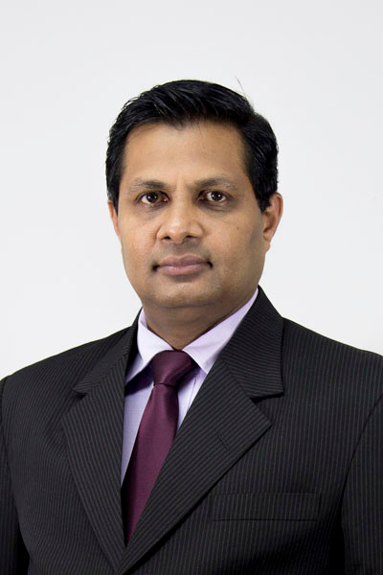
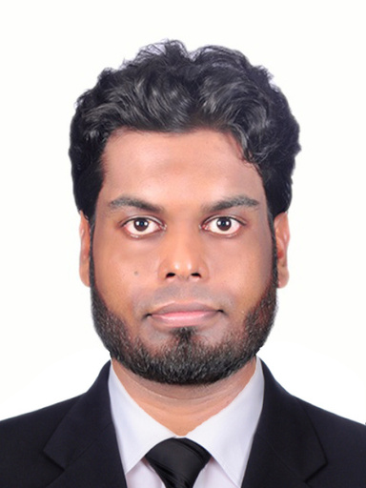
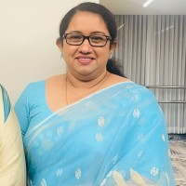
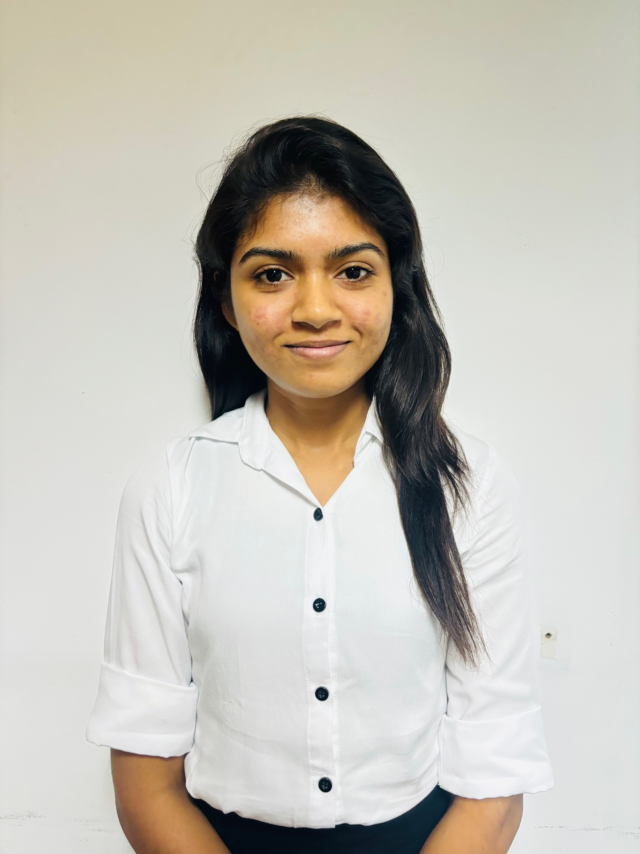
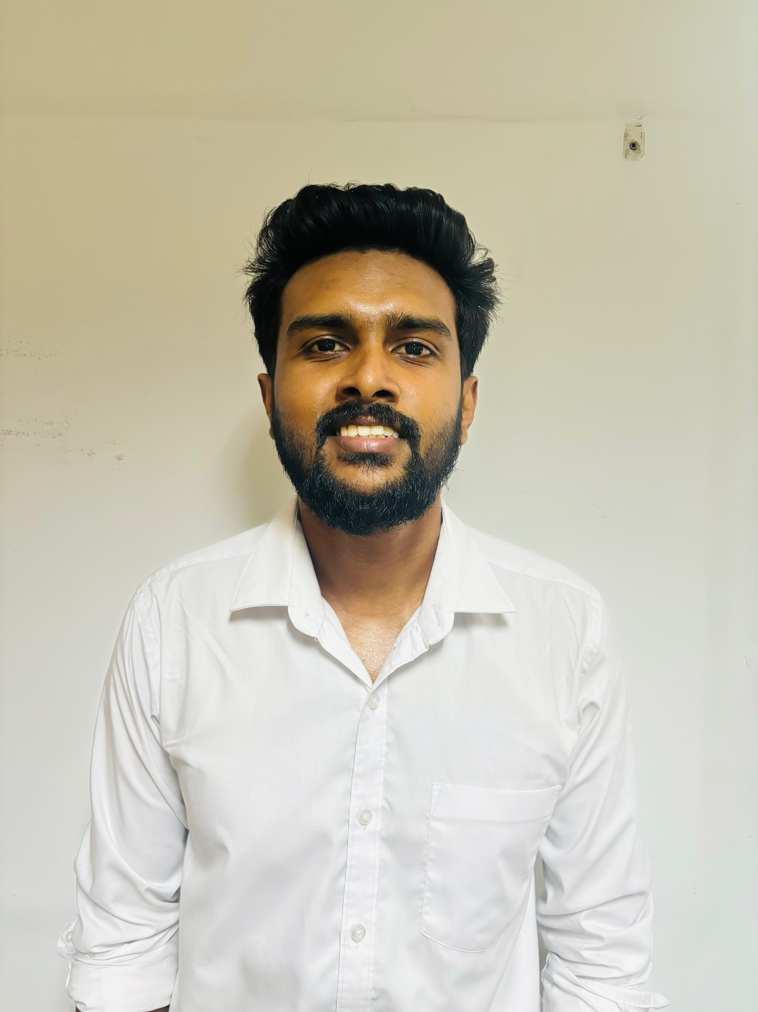
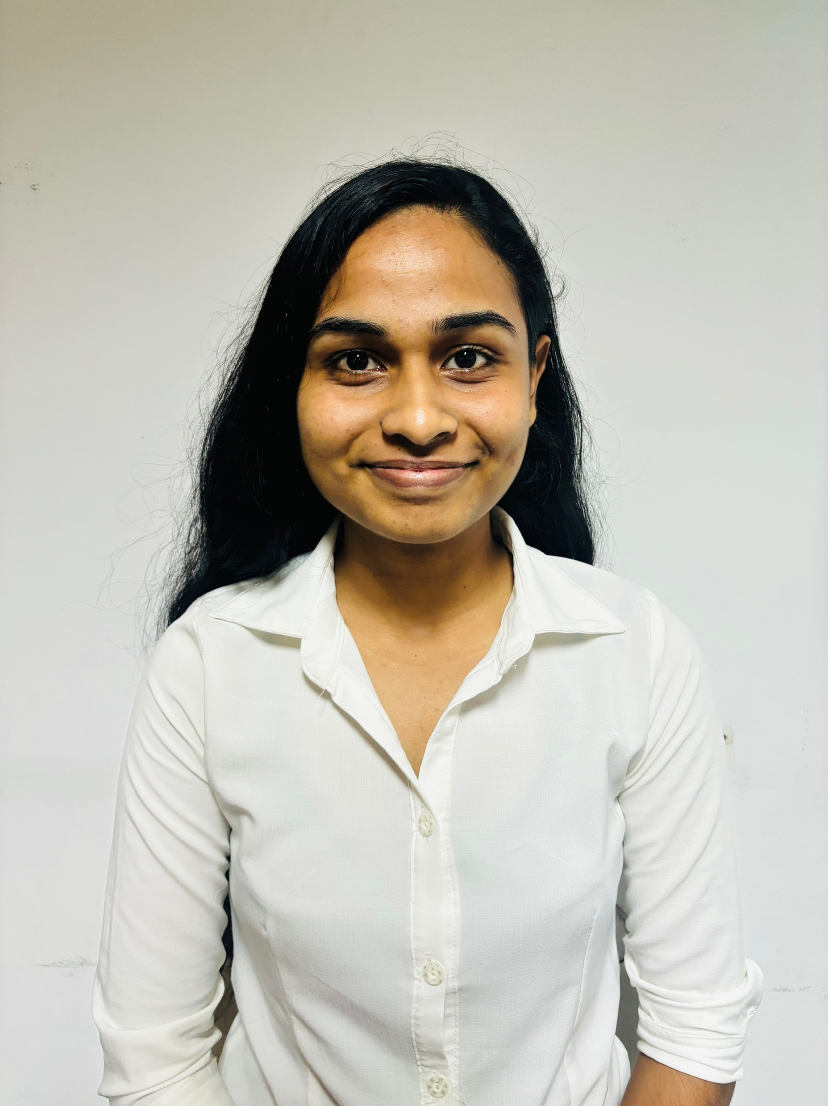
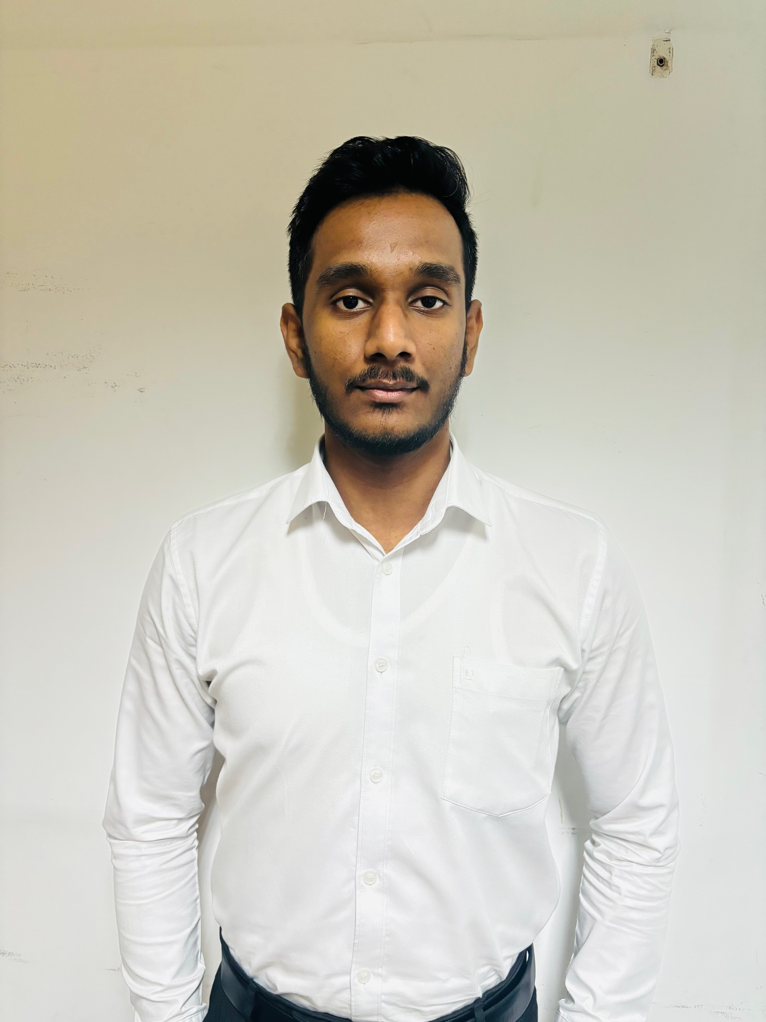
OUR TEAM
Prof. Samantha Thelijjagoda
Supervisor
Dr. Junius Anjana
Co - Supervisor
Dr Asiri Hewamalage
External Supervisor
Silva T.U.D
IT21318320
Madusanka G.K.I
IT21189944
Thalangama T.P
IT21223594
Dissanayake M.G.T.W
IT21319174

Slide 3
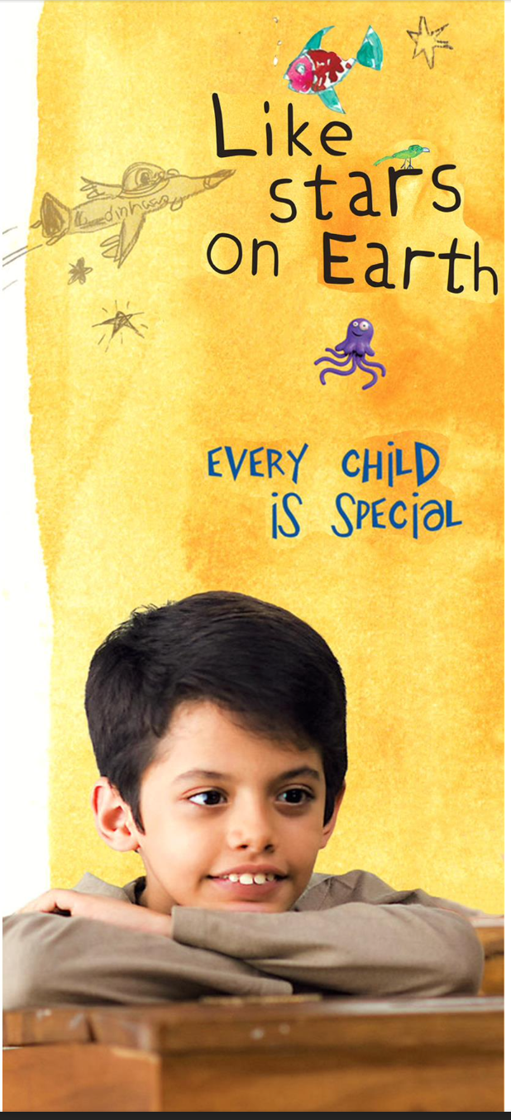
CONTENT
Introduction
2. Research Question
3. Research Gap
4. Proposed System
5. Technologies
6. Domain Expertise and data requirement
7. Individual Components
8. Commercialization Aspects
9. Budget
10. Gantt chart

Slide 4
INTRODUCTION

Slide 5
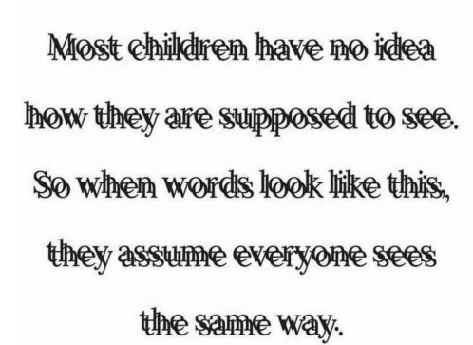

Slide 6
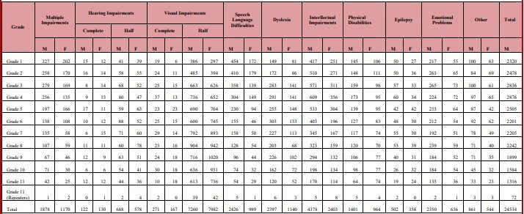
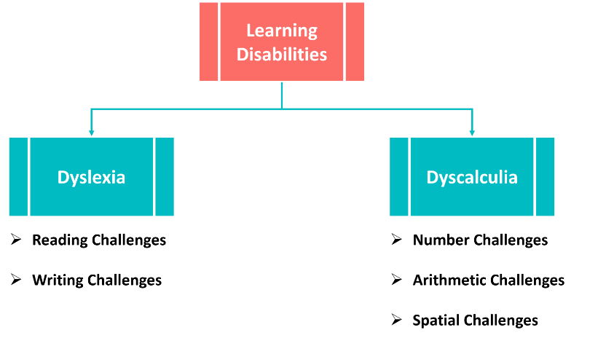
Disability among Students in General Class and Government Schools, Recorded in the Year 2019

Slide 7
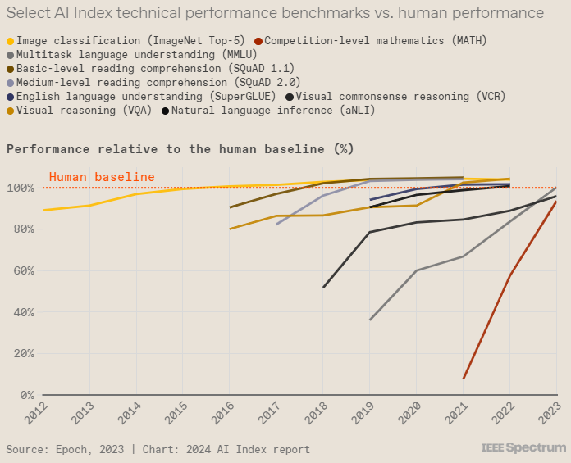
WHY NOT A TECH SOLUTION?
Select AI Index technical performance benchmarks vs. human performance

Slide 8
RESEARCH QUESTION

Slide 9

Lack of adaptive educational lessons
Need for systems that detect emotional and engagement cues.
Need for personalized and multisensory teaching methods.
Need for audio adjusting features.

Slide 10
OBJECTIVES

Slide 11

Develop a personalized assistive learning platform for children with dyslexia and dyscalculia

Slide 12
Sub Objectives
Enhance reading skills using color variations.
Implement personalized audio output based on speech pace detection.
Improve mathematical skills using the Touch Math approach.
Use real-time emotion detection to adapt tasks dynamically and provide supportive guides.

Slide 13
SYSTEM OVERVIEW DIAGRAM

Slide 14
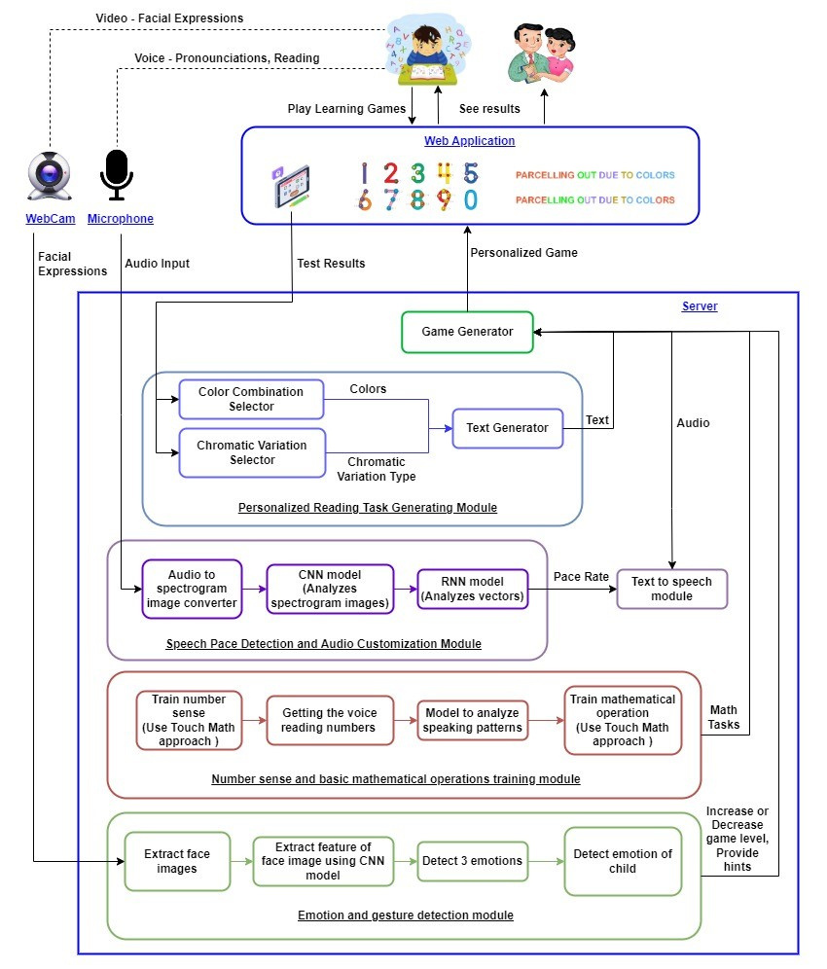

Slide 15
AGILE SOFTWARE
DEVELOPMENT

Slide 16
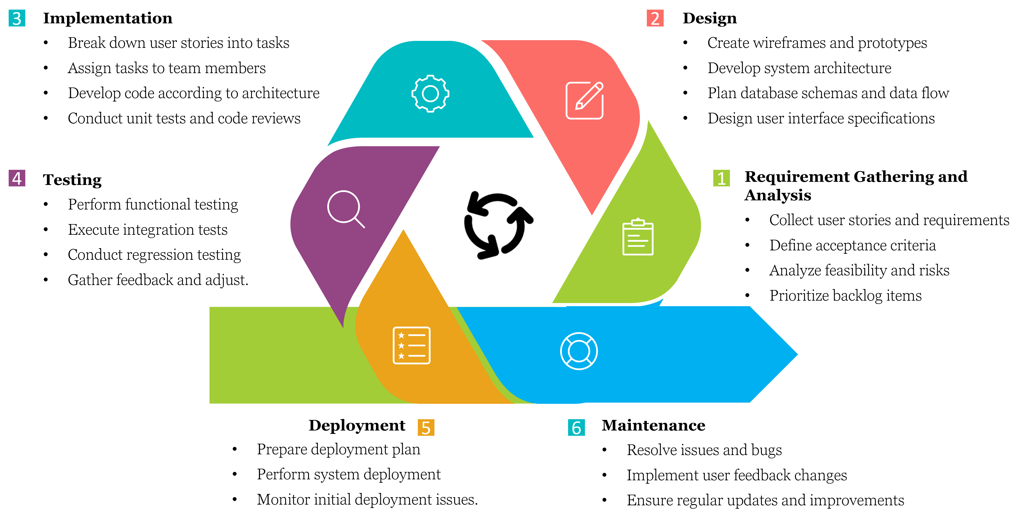
Software Development Life Cycle

Slide 17
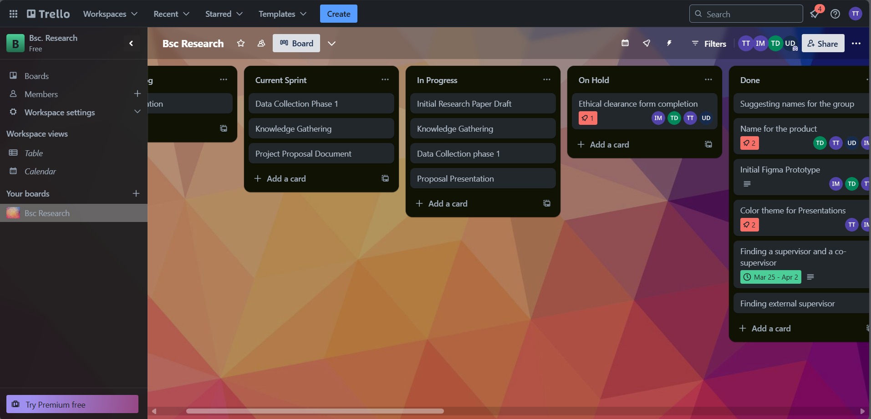

Project Management Dashboard
Figma Prototype

Slide 18
TECHNOLOGIES

Slide 19









Frontend
React
Ant Design
Backend
Flask
Node Js
Machine Learning and Deep learning
Python
Jupyter Notebook
TensorFlow
Keras
OpenCV
Keggale
Version Control and Project Management
Github
Trello
Technical Concepts
Machine Learning
Image Processing
Convolutional Neural Network (CNN)
Recurrent Neural Network (RNN)
Containerization
Microservices

Slide 20
INDIVIDUAL COMPONENTS

Slide 21
IT21189944 | Madusanka G.K.I
BSc (Hons) Degree in Information Technology (specialization in Software Engineering)

Slide 22
EMOTION RECOGNITION TO PROVIDE REAL-TIME ADAPTIVE FEEDBACK AND ADJUST GAME DIFFICULTY LEVEL
IT21189944 | Madusanka G.K.I | 24-25J-233

Slide 23


Research Gap
 | A | B | C | D | E | LexAyudha
Rehabilitation Activities
Report Generation
Detect User’s emotion
Provide Personalized feedback to guardian
Focus on Student’s stress level
Keep track of progress
Personalized Rehabilitation
a - A Mobile-Based Screening and Refinement System to Identify the Risk of Dyscalculia and Dysgraphia Learning Disabilities in Primary School Students[1]
b - Developing two game-based interventions for dyslexia therapeutic interventions using gamification and serious games approaches entertainment computing journal[2]
c - Effectiveness of digital game-based trainings in children with neurodevelopmental disorders[3]
IT21189944 | Madusanka G.K.I | 24-25J-233

Slide 24
Research Problem
How do we create
A system that provide
Real time emotion detection to reduce stress level
Support student by dynamically changing the activity level
Personalized Feedback to guardian with child’s emotion status
IT21189944 | Madusanka G.K.I | 24-25J-233

Slide 25
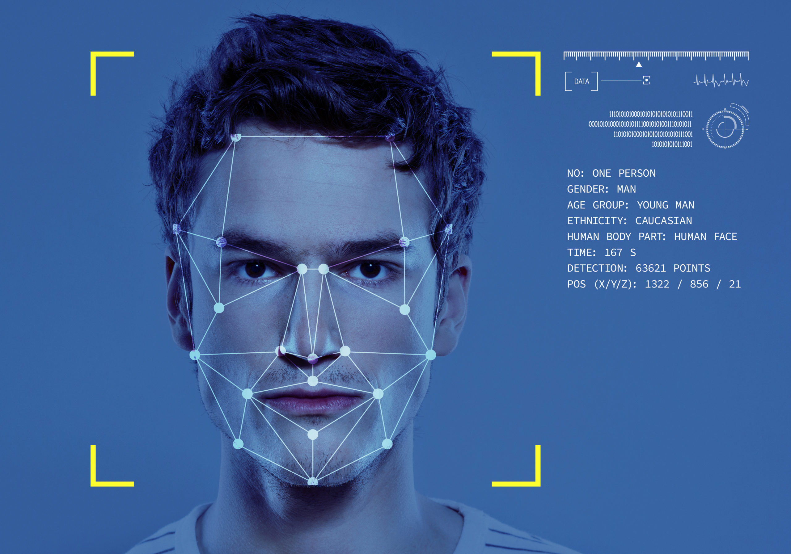
Objectives
SPECIFIC OBJECTIVE
Emotion Recognition to provide real-time adaptive feedback and adjust activity difficulty level
SUB OBJECTIVES
Detect emotion and identify the emotion class
Dynamically change acitivity difficulty level
Keep track of student emotional records with relevet activity
Generate Personalized feedback for guardian
IT21189944 | Madusanka G.K.I | 24-25J-233

Slide 26

Objectives Cont.
Key Emotions (5):
1. Happiness
2. Sadness
3. Surprise
4. Anger
5. Neutral
Main Classes (3):
1. Distraction (neutral, surprise)
2. Frustration (sadness, anger)
3. Engagement (happiness, neutral)
IT21189944 | Madusanka G.K.I | 24-25J-233

Slide 27
Technologies to be used
Facial Emotion Recognition
TensorFlow
Keras
PyTorch
Algorithms
MTCNN algorithm
Facial Landmark Algorithm
Computer Vision
OpenCV
Dlib
Backend Technologies
Flask
Node js
Frontend Technologies
React js
Chart js
IT21189944 | Madusanka G.K.I | 24-25J-233

Slide 28
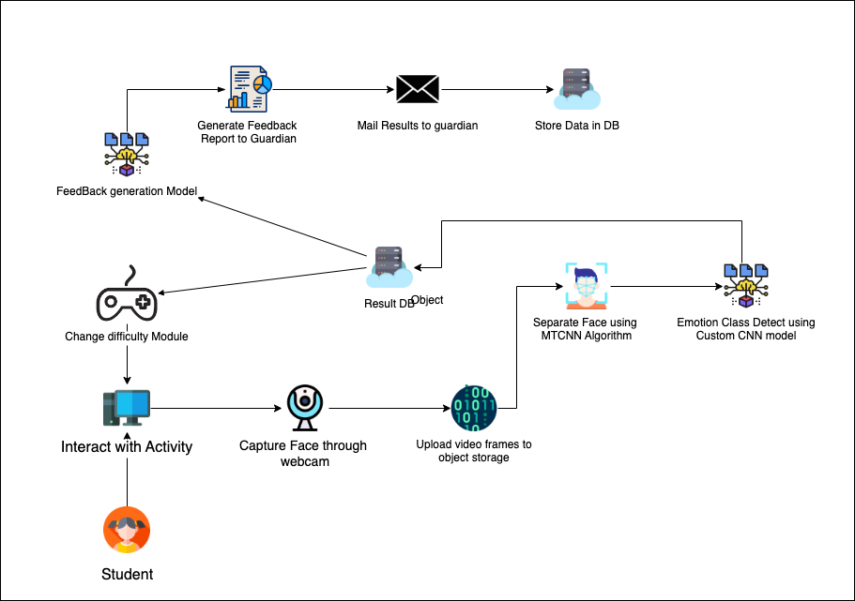
System Diagram
IT21189944 | Madusanka G.K.I | 24-25J-233

Slide 29
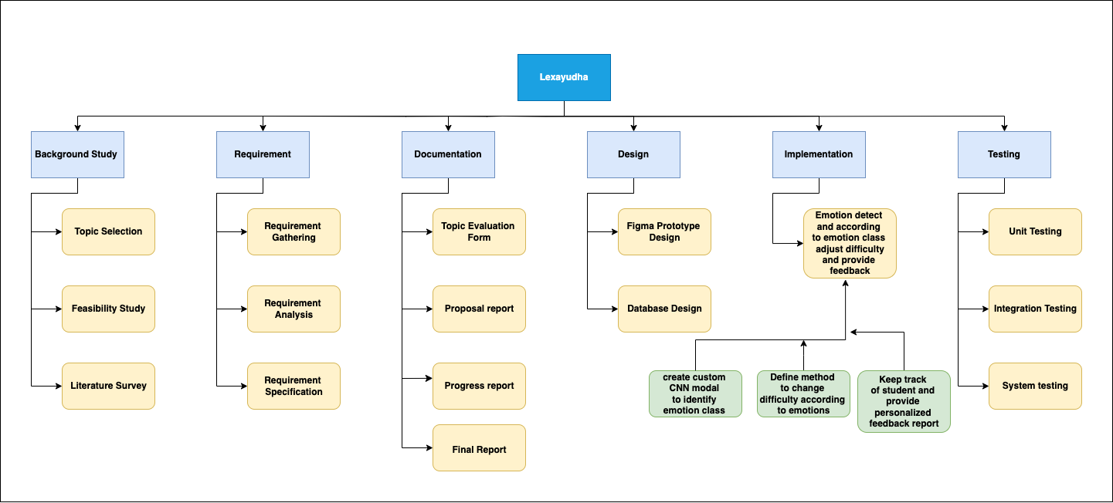
Work Breakdown Structure
IT21189944 | Madusanka G.K.I | 24-25J-233

Slide 30
Requirements
System Requirements​
Stable internet connection.​
High Definition Web Cam
​
Personal Requirements ​
Consent to capture Video Data.​
Clear & Well lit environment.​
Software Requirements
Web browser with WebCam access.​ ​
Functional Requirements​
User Logs in to system.​
Capture Video Realtime.​
Recognize facial emotions
Dynamically change difficulty level
Generate Personalized feedback report
IT21189944 | Madusanka G.K.I | 24-25J-233

Slide 31
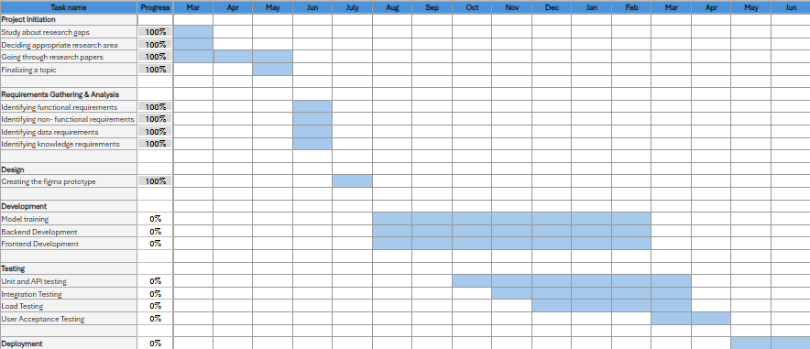
Gannt Chart
IT21189944 | Madusanka G.K.I | 24-25J-233

Slide 32
References
[1] De Saram, E., Maduranga, A., Pathirage, G. P., Dewanmini, S., Thelijjagoda, S., & Krishara, J. (2023). WaliPilla: Mobile based screening and refinement system to identify the risk of reading weaknesses due to dyslexia. 2022 4th International Conference on Inventive Research in Computing Applications (ICIRCA). https://doi.org/10.1109/icacta58201.2023.10393657
[2] Manalu, H. V., & Rifai, A. P. (2024). Detection of human emotions through facial expressions using hybrid convolutional neural network-recurrent neural network algorithm. Intelligent Systems With Applications, 21, 200339. https://doi.org/10.1016/j.iswa.2024.200339
[3] Pan, Z., Wang, Y., & Zhang, S. (2022). Joint face detection and Facial Landmark Localization using graph match and pseudo label. Signal Processing. Image Communication, 102, 116587. https://doi.org/10.1016/j.image.2021.116587
[4] Agarwal, H., Mahajan, G., Shrotriya, A., & Shekhawat, D. (2024). Predictive data analysis: Leveraging RNN and LSTM techniques for time series dataset. Procedia Computer Science, 235, 979–989. https://doi.org/10.1016/j.procs.2024.04.093
IT21189944 | Madusanka G.K.I | 24-25J-233

Slide 33
IT21319174 |Dissanayake M.G.T.W
BSc (Hons) Degree in Information Technology (specialization in Software Engineering)

Slide 34
TOUCH MATH APPROACH FOR ENHANCING NUMBER SENSE AND MATHEMATICAL OPERATIONS
IT21319174 | Dissanayake M.G.T.W | 24-25J-233

Slide 35
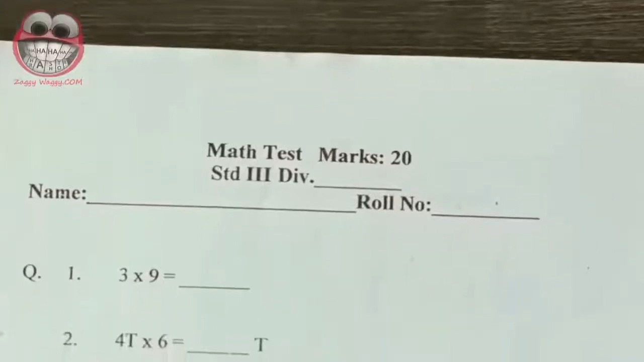
Background
What is the answer?
3 x 9 = ?
IT21319174 | Dissanayake M.G.T.W | 24-25J-233

Slide 36

Research Problem
Lack Analytical Skills
Inadequancy of Traditional Methods
Need Alternative Approches
Need more personalized study process
IT21319174 | Dissanayake M.G.T.W | 24-25J-233

Slide 37

Research Gap
Limited technology integration with Touch Math approach
Students less interactions with existing systems.
Lack personalized platforms.
IT21319174 | Dissanayake M.G.T.W | 24-25J-233

Slide 38
System Comparison
 | A | B | C | D | Lexayudha
Use TouchMath Approach
Technology Integration
Personalized Activities
Use Attractive interfaces (Multisensory)
Voice Recognition Techniques
Provide activities to improve the math concepts.
Teaching Process
A - A review of the articles about TouchMath [1] B - Touch math pro[3]
C - TouchMath Tutor Kindergarten Demo[2] D - Nanashilpa
IT21319174 | Dissanayake M.G.T.W | 24-25J-233

Slide 39
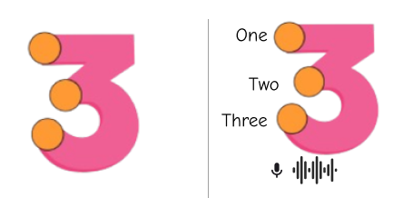
Objectives
SPECIFIC OBJECTIVE
Touch math approach for enhancing number sense and mathematical operations
SUB OBJECTIVES
Implement test to identify most difficult areas
Providing learning and practice sessions, utilizing touch mach approach
Integrate voice recognition to analyze number pronunction
Generate performance report
IT21319174 | Dissanayake M.G.T.W | 24-25J-233

Slide 40
Technologies to be used
Natural Language Processing
TensorFlow
Keras
Speech to text
Google Cloud Speech-to-Text API
Backend Technologies
Flask
Node js
Frontend Technologies
React js
Canvas API
IT21319174 | Dissanayake M.G.T.W | 24-25J-233

Slide 41
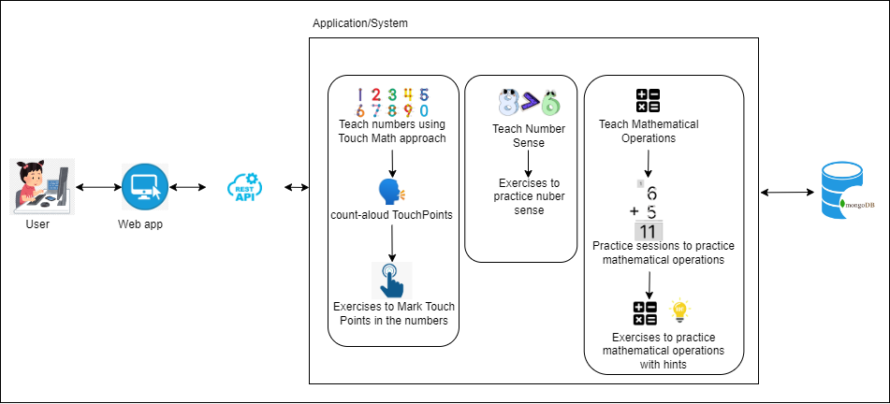
System Diagram
IT21319174 | Dissanayake M.G.T.W | 24-25J-233

Slide 42
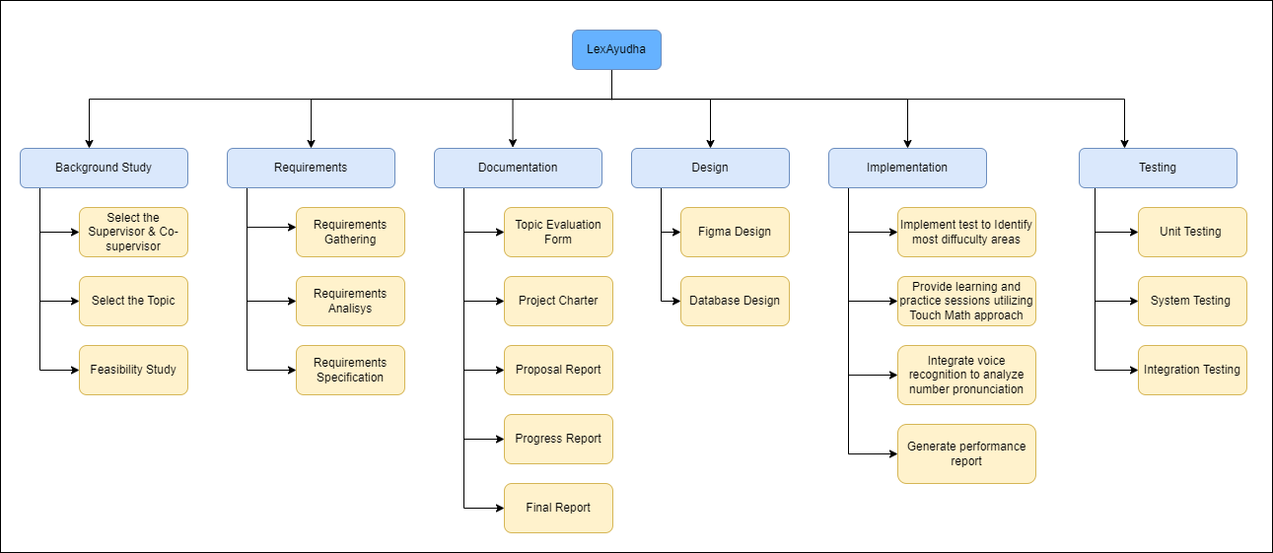
Work Breakdown Structure
IT21319174 | Dissanayake M.G.T.W | 24-25J-233

Slide 43
Requirements
Functional Requirements​
Create an account and login to the system
Perform test to identify most difficult areas
Perform learning and practice session
Non-Functional Requirements ​
Reliability
Accuracy
Security
​
System Requirements​
User-friendly and accessible design.​
Enable touch points
A microphone
Personal Requirements ​
Concern to use touch points
Concern about capturing speech audio data
Clear voice volume
Software Requirements
Web browser with microphone access​ ​
IT21319174 | Dissanayake M.G.T.W | 24-25J-233

Slide 44
Gannt Chart
IT21319174 | Dissanayake M.G.T.W | 24-25J-233

Slide 45
References
[4]Aydemir, Tamer. “A Review of the Articles about TouchMath.” Procedia - Social and Behavioral Sciences, vol. 174, 12 Feb. 2015, pp. 1812–1819, www.sciencedirect.com/science/article/pii/S1877042815008940, https://doi.org/10.1016/j.sbspro.2015.01.842.
[5]Innovative Learning Concepts, Inc. TouchMath Tutor Kindergarten Demo, 14 Nov. 2023, touchmath-tutor-kindergarten-demo.software.informer.com/. Accessed 7 Aug. 2024.
[6]“TouchMath PRO.” TouchMath Pro, 2021, touchmath.com/pro/.
IT21319174 | Dissanayake M.G.T.W | 24-25J-233

Slide 46
IT21223594 |Thalangama T.P
BSc (Hons) Degree in Information Technology (specialization in Software Engineering)

Slide 47
ENHANCING READABILITY AND
SPEAKING SKILLS IN DYSLEXIC ADOLESCENTS THROUGH
PERSONALIZED SPEECH PACE​
IT21223594 | Thalangama T.P. | 24-25J-233

Slide 48
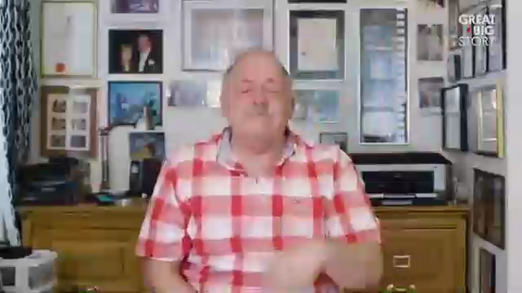
Background – Why Speech phase ?
For Dyslexic adolescents,​
Normal speech pace -> Hard to follow.​
Fast speech -> Confusing.​
Slower talking -> Easier to understand.​
Custom speed -> Better learning.​
IT21223594 | Thalangama T.P. | 24-25J-233

Slide 49
Research Problem
Personalized speech pace needed.​
Current detection methods exist.​
Existing methods have limitations.​
New, accurate method required. ​
​
IT21223594 | Thalangama T.P. | 24-25J-233

Slide 50
Research Gap
Research | Detect Spatial and temporal features in data | Analyses data for speech features | Utilizes hybrid model for improved accuracy | Generates a personalized speech pace | Utilizes the generated results for personalized speech
Human age estimation through audio utilising MFCC and RNN [7]
An autonomous and intelligent hybrid CNN-RNN-LSTM based approach for the detection and classification of abnormalities in brain.[8]
LexAyudha
IT21223594 | Thalangama T.P. | 24-25J-233

Slide 51
System Comparison
 | A | B | C | D | Lexayudha
Use Deep Learning methods
Detects speech pace
Adjustable speech pace
Automated speech pace adjustment
Provides personalized speech pace
A – Speechace B - Speechify
C - TextAid D - Nanashilpa
IT21223594 | Thalangama T.P. | 24-25J-233

Slide 52

Objectives
SPECIFIC OBJECTIVE
Develop AI speech pace system for personalized learning
SUB OBJECTIVES
Detect speech pace through voice data.
Analyzing voice features.
Integrating detected speech pace with text to speech(TTS) model
System evaluation and validation.
IT21223594 | Thalangama T.P. | 24-25J-233

Slide 53
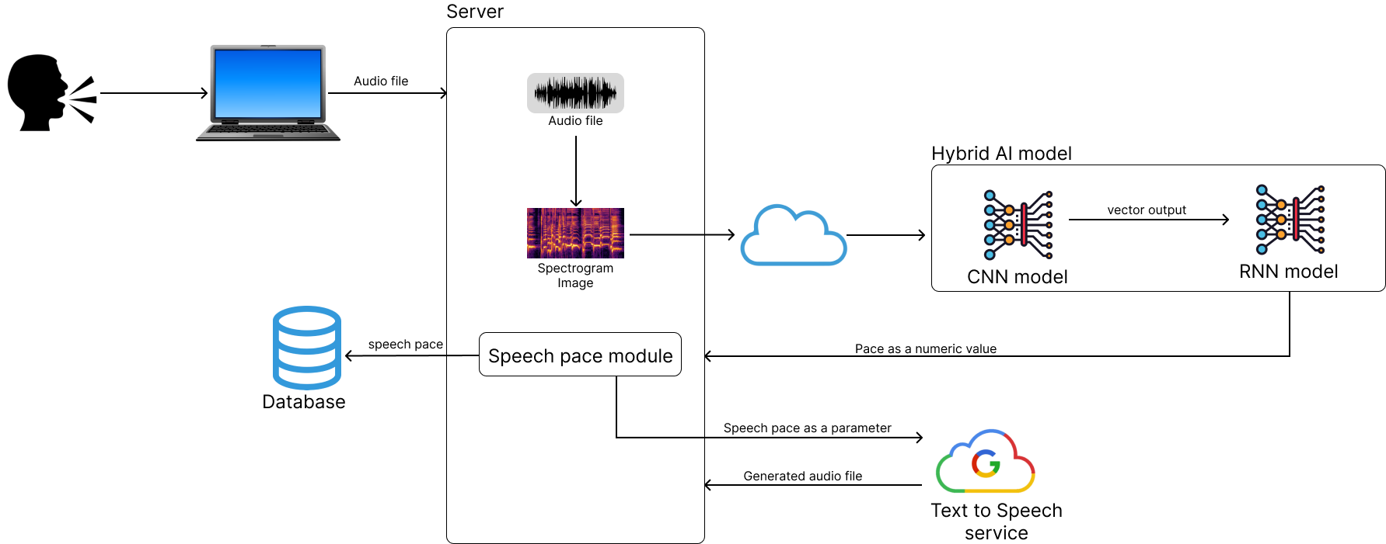
Proposed Methodology
IT21223594 | Thalangama T.P. | 24-25J-233

Slide 54

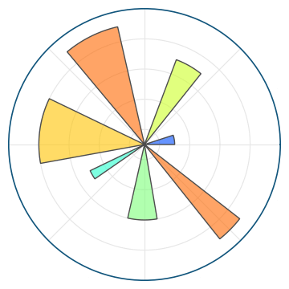



Technologies to be used
Audio conversion to spectrogram images –
Librosa python library
Matplotlib python library
CNN-RNN hybrid model training –
TensorFlow
PyTorch
Text to Speech model –
Google Cloud Text to Speech
IT21223594 | Thalangama T.P. | 24-25J-233

Slide 55
Requirements
System Requirements​
Stable internet connection.​
A microphone.​
Personal Requirements ​
Consent to capture speech audio data.​
Clear & sufficient speech volume.​
Software Requirements
Web browser with microphone access.​ ​
Functional Requirements​
Automated speech pace detection.​
Customized speech pace for each individual.​
Non-functional Requirements ​
Speech pace accuracy.​
Reliability & availability .​
IT21223594 | Thalangama T.P. | 24-25J-233

Slide 56
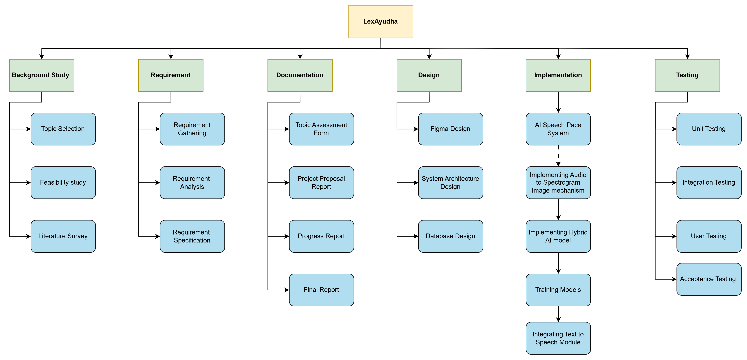
Work Breakdown Structure
IT21223594 | Thalangama T.P. | 24-25J-233

Slide 57
Gannt Chart
IT21223594 | Thalangama T.P. | 24-25J-233

Slide 58
References
[7] Chandra, W., Ken, K., Quinn, O., & Pardosi, I. A. (2023). Human age estimation through audio utilising MFCC and RNN. Sinkron, 8(3), 1852–1862. https://doi.org/10.33395/sinkron.v8i3.12656
[8] Datta, P., & Rohilla, R. (2024). An autonomous and intelligent hybrid CNN-RNN-LSTM based approach for the detection and classification of abnormalities in brain. Multimedia Tools and Applications, 83(21), 60627–60653. https://doi.org/10.1007/s11042-023-17877-3
[9] Hussein, N. A., Abdulameer, N. a. T., Abdulkarim, N. A., Husni, N. H., & Al-Ubaidi, N. D. (2024). Classification of dyslexia among school students using deep learning. Journal of Techniques, 6(1), 85–92. https://doi.org/10.51173/jt.v6i1.1893
[10]Agarwal, H., Mahajan, G., Shrotriya, A., & Shekhawat, D. (2024). Predictive data analysis: Leveraging RNN and LSTM techniques for time series dataset. Procedia Computer Science, 235, 979–989. https://doi.org/10.1016/j.procs.2024.04.093
IT21223594 | Thalangama T.P. | 24-25J-233

Slide 59
IT21318320 | Silva T.U.D
BSc (Hons) Degree in Information Technology (specialization in Software Engineering)

Slide 60
Teaching based on
Chromatic Variations
For Dyslexics
to improve Reading Skills
IT21318320 | Silva T.U.D | 24-25J-233

Slide 61
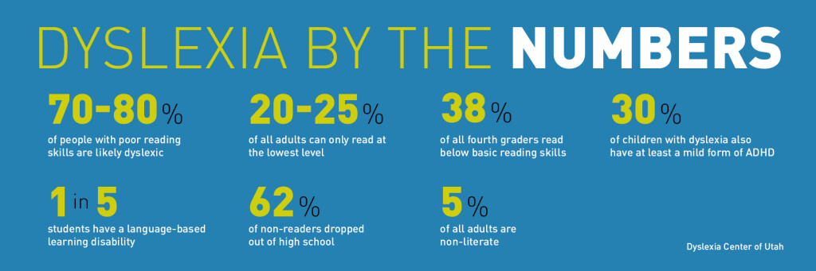
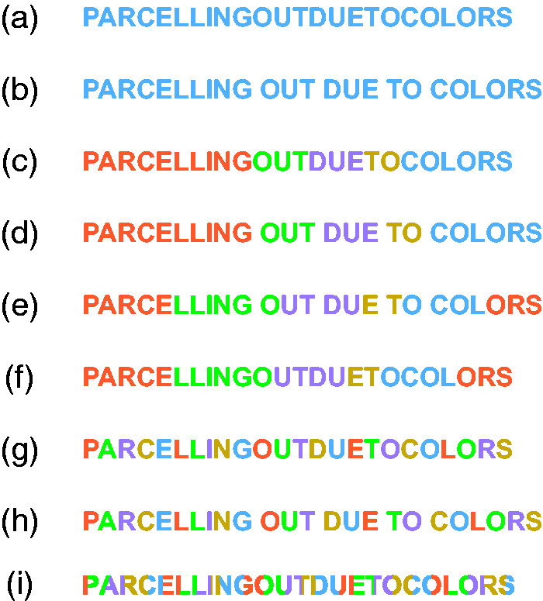
Background
Statistics
IT21318320 | Silva T.U.D | 24-25J-233

Slide 62

Background
Word recognition difficulties
Poor spelling
Problems decoding letters and words
Reading below the expected level for age
Slow and labor-intensive reading and writing
Avoidance of activities that involve reading
IT21318320 | Silva T.U.D | 24-25J-233

Slide 63
Research Gap
Assistive Learning Environment for Students with Learning Disabilities
AI-based systems for Dyslexic Students
Interactive Reading Tools for Dyslexic Students
Develop an Assistive Learning Environment (ALE) for students with learning disabilities.
Develop AI-driven t systems to assist with reading difficulties
Develop interactive tools to aid reading for dyslexic students.
Utilize natural language processing (NLP) to convert text into speech, making reading easier for dyslexic students.
Provide a flexible environment allowing students to follow activities at their own pace.
Utilize multimedia elements like audio and visual aids to enhance reading comprehension.
IT21318320 | Silva T.U.D | 24-25J-233

Slide 64
System Comparison
 | A | B | C | D | Lexayudha
Chromatic Variation approach
Best suited chromatic variation detection
Color variation effectiveness
Best suited color variation detection
Complexity adjustments
Personalized Lessons
Text to Speech
Text Highlighting
User Friendliness
Possess a web/mobile app
A - On the Role of Color in Reading and Comprehension Tasks in Dyslexic Children and Adults[11] C- Nessy
B - Chromatic visual evoked potentials: A review of physiology, methods and clinical applications[12] D – Claro Speek
IT21318320 | Silva T.U.D | 24-25J-233

Slide 65
Research Problem
Identify the most suitable category of the chromatic variation
Identify the appropriate complexity levels of the activities
Generate personalized activities
Monitor the recovery of the adolescents
IT21318320 | Silva T.U.D | 24-25J-233

Slide 66
Objectives
SPECIFIC OBJECTIVE
Identify the appropriate chromatic variation types and color combinations, provide a personalized activity plan.
SUB OBJECTIVES
Sample test to identify the efficient color combinations
Sample test to identify the most efficient chromatic variation type
Test to check the reading skills to customize the complexity levels of the tasks
Create personalized reading task plans
IT21318320 | Silva T.U.D | 24-25J-233

Slide 67
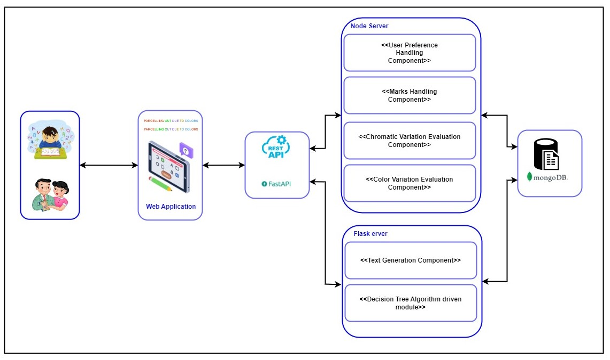
Methodology
IT21318320 | Silva T.U.D | 24-25J-233

Slide 68
Technologies to be used
Natural Language Processing
TensorFlow
Keras
Containerization and other technologies
Database
Docker
Kubernetes
Fast API
MongoDB
Backend Technologies
Algorithms
Flask
Node js
Decision Tree
Frontend Technologies
React js
Canvas API
IT21318320 | Silva T.U.D | 24-25J-233

Slide 69
Requirements
Functional Requirements​
Create a personal account and access the application
Perform suited chromatic variation and color variation tests
View and learn personalized lessons
Perform quizzes and assess the performance
Non-Functional Requirements
Reliability
Accuracy
Security​ ​
System Requirements​
Stable internet connection.​
A microphone.​
Personal Requirements ​
Consent to provide speech audio data.​
Software Requirements
Web browser with microphone access.​ ​
IT21318320 | Silva T.U.D | 24-25J-233

Slide 70
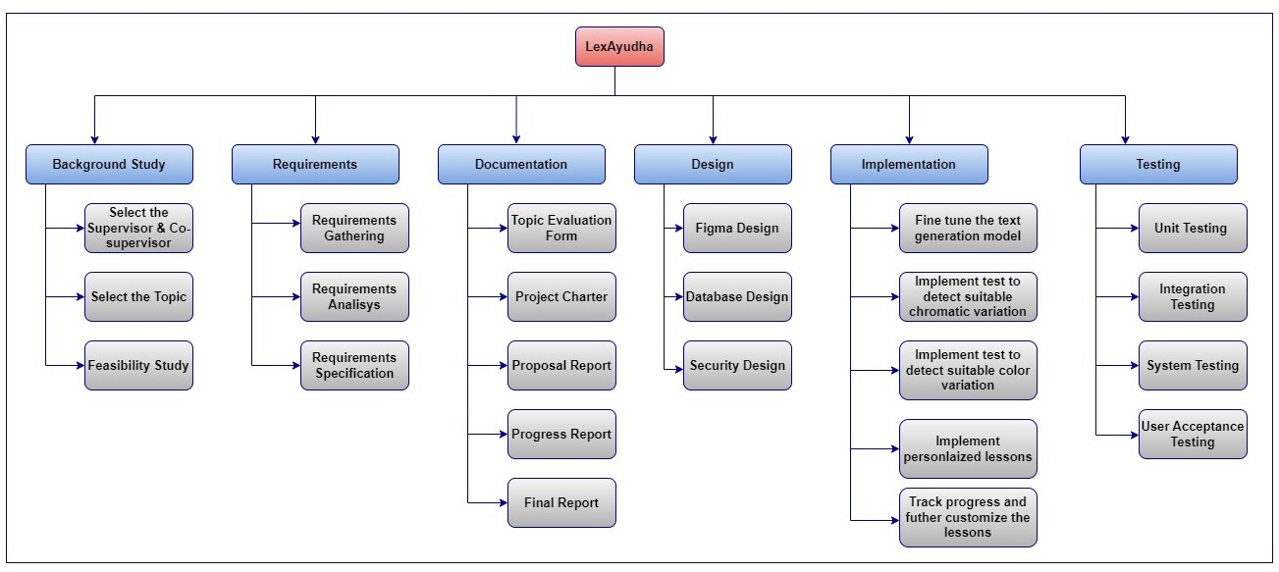
Work Breakdown Chart
IT21318320 | Silva T.U.D | 24-25J-233

Slide 71
Gannt Chart
IT21318320 | Silva T.U.D | 24-25J-233

Slide 72
References
[11] Alsobhi, A. Y., Khan, N., & Rahanu, H. (2014). Toward linking dyslexia types and symptoms to the available assistive technologies. 2014 IEEE 14th International Conference on Advanced Learning Technologies. https://doi.org/10.1109/icalt.2014.174
[12] Raghuram, A., Hunter, D. G., Gowrisankaran, S., & Waber, D. P. (2019). Self-reported visual symptoms in children with developmental dyslexia. Vision Research, 155, 11–16. https://doi.org/10.1016/j.visres.2018.11.007
[13] Pinna, B., & Deiana, K. (2018). On the Role of Color in Reading and Comprehension Tasks in Dyslexic Children and Adults. i-Perception, 9(3), 204166951877909. https://doi.org/10.1177/2041669518779098
IT21318320 | Silva T.U.D | 24-25J-233

Slide 73
COMMERCIALIZATION ASPECT

Slide 74

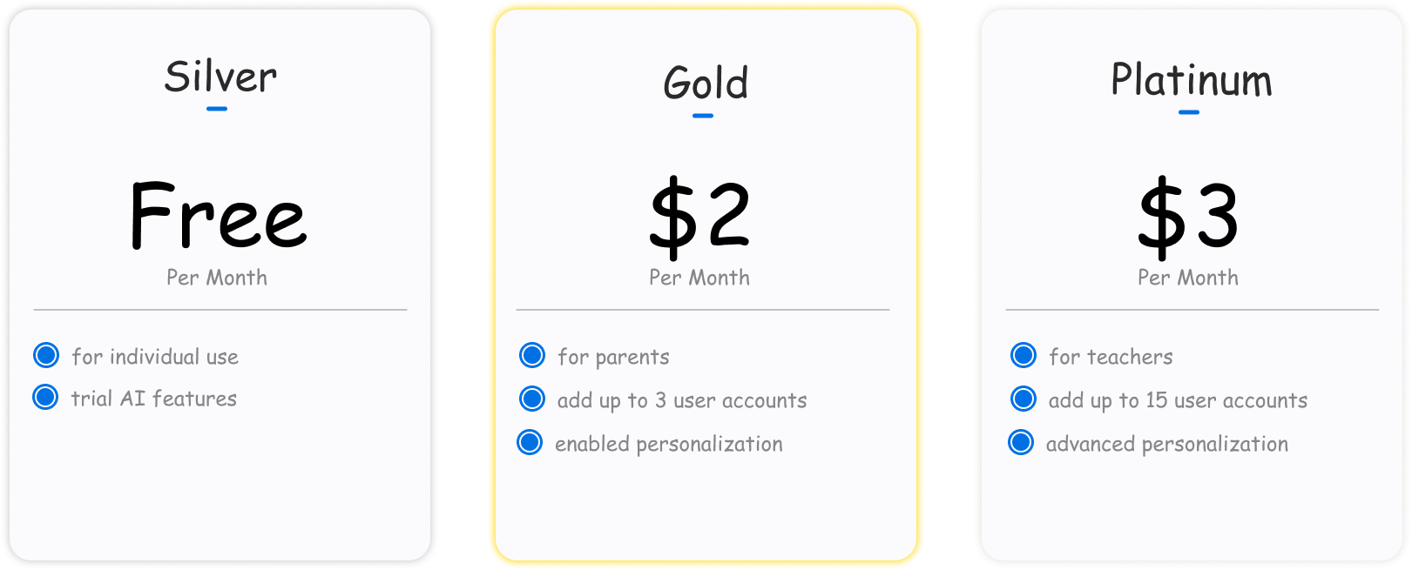
Monetizing Aspect
Subscription based business model
Donation enabled

Slide 75
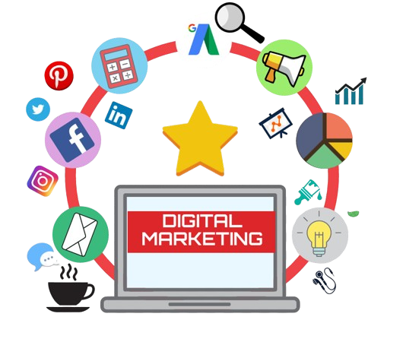
Marketing Aspect
Primary Target Audience: The parents of learning divergent adolescents
Secondary Target Audience: Educators, Special education professionals
Digital Marketing
Social media marketing
Blogs
Email marketing
Partnerships
Collaboration with schools
Collaboration with dyslexic educational institutes

Slide 76
Budget
Description | Cost
Vercel – Frontend Deployment | Free Tier
Render – Backend Deployment | Free Tier
Azure Cosmos DB | Free Tier(25GB Lifetime)
Azure Blob Storage | $0.018 per GB (First 5GB Free)
Google speech to Text | 1 hour free for month | $0.006 per 15 seconds over 60 mins up to 1 million mins
Azure App Services – Application Deployment | Free Tier
Google Colab Pro (If free tier not enough for Deep Learning Model Training) | $9.99

Slide 77
GANTT CHART
5/26/2025

Slide 78
Gantt Chart

Slide 79
THANK YOU
AI-based Personalized Rehabilitation for Dyslexia and Dyscalculia Adolescents

Slide 80

ANY QUESTIONS?

